Slide 1






PYTHON BEGINNER COURSE
2024
2024
PYTHON
BEGINNER COURSE
Lesson 0
SHALEV LAU
/in/shalevl
/mushroomhater07

Slide 2
Introduction
Introduce Enactus
Social Media
Why learn Python
IDE selection
Introduce Terminal
VS Code Installation
Python Installation
Git Usage
Generative AI

Slide 3
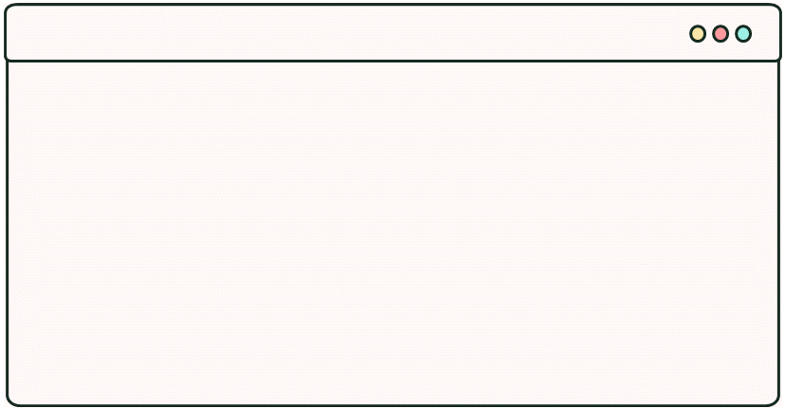
Question:
DOES ANYONE KNOW
WHY WE CALLED
THIS WEEK 0?

Slide 4
Answer: Why Week 0
Arrays in Python (and most programming languages) are 0-indexed so you count from 0 instead of one.
I’m going to leave you on a cliff-hanger until we learn more about Python’s data structures.
I believe we should walk before we can run, so we should learn the fundamentals first.

Slide 5



Thank you
University Life is busy.
We appreciate you spent your time wisely with us.
We hope you get the most out of this course.
By signing up for the course:
- You joined the community
- You get constant support from many other our experienced mentors
- You have help funded our social enterprises
OnTarget
CARTE
Vape Drop

Slide 6








Meet The Team
Rikzar
Rokas
Julian
Project Manager
Deputy Proj. Manager
Financial
Amin
Izenith
Shalev
Marketing
Outreach
Program Developer
Nedjm
Haris
Jivanthika
Program Developer
Mentor
Mentor

Slide 7



Follow Our Social
Instagram @code_creators
- Keep you updated
- quick DM reply with queries relating to finance
- See what goes on at CC
Discord Server discord.gg/DX3S8EURz2
- Support from CC Mentors
- Private community for CodeCreators members
GitHub Resource
@ccsheff24
- Starter project files are here.
- Contribute to open source.

Slide 8
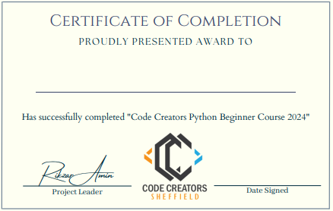
Certificate
After you have completed our final project, you will be awarded with a digital website friendly version of certificate of completion tailored for you to upload on LinkedIn profile or your own CV.

Slide 9
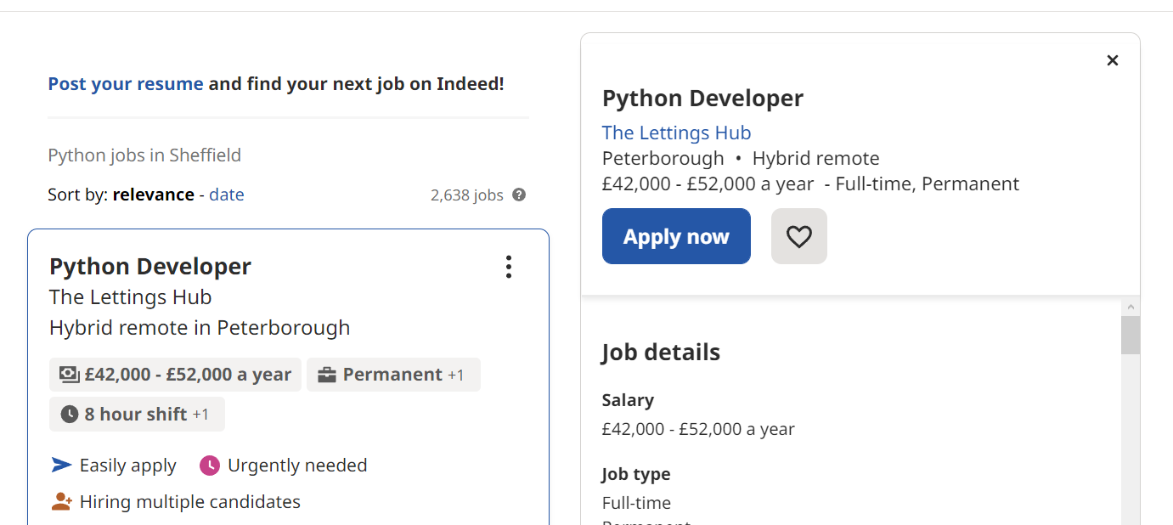
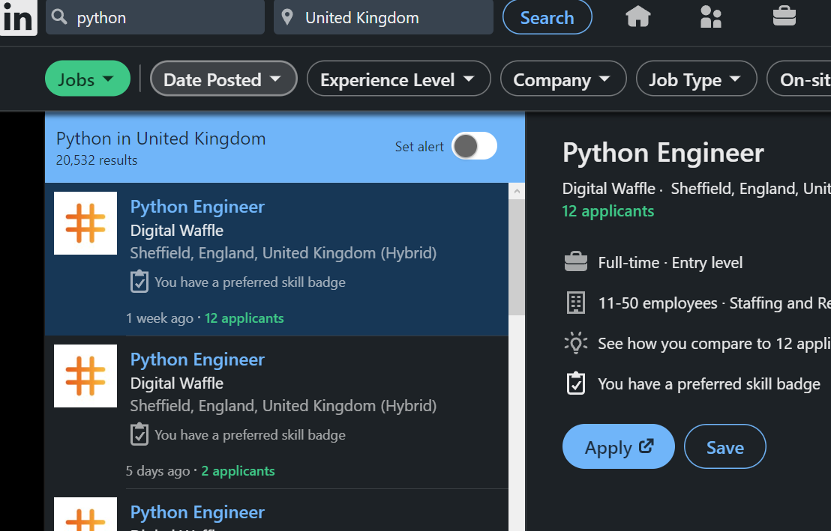
Why learn Python: EVERGROWING POPULARITY
26
(% SHARE IN 2022)
21
You won’t be
short of employment
after learning Python!
8.3
7.6
7.3
6.3
PYTHON
4
JAVA
JS
C#
C
PHP
R

Slide 10


Why learn Python: BEGINNER FRIENDLY
Python provides simple syntax to write your code. This is thanks to its indentation style, lack of triviality like terminating semi-colons or type definitions and a rich in-built standard library. Less time for errors, more time for coding!
PYTHON
C
# no import needed
print("Code Creators!")
#include <iostream>
using namespace std;
int main(int argc, char * argv[])
{
cout << "Hello, world!" << endl;
return 0;
}

Slide 11
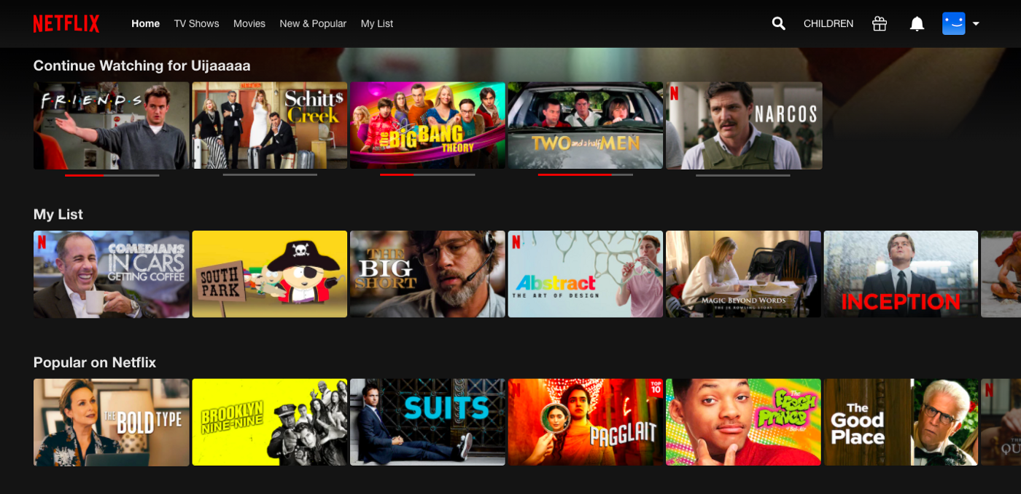

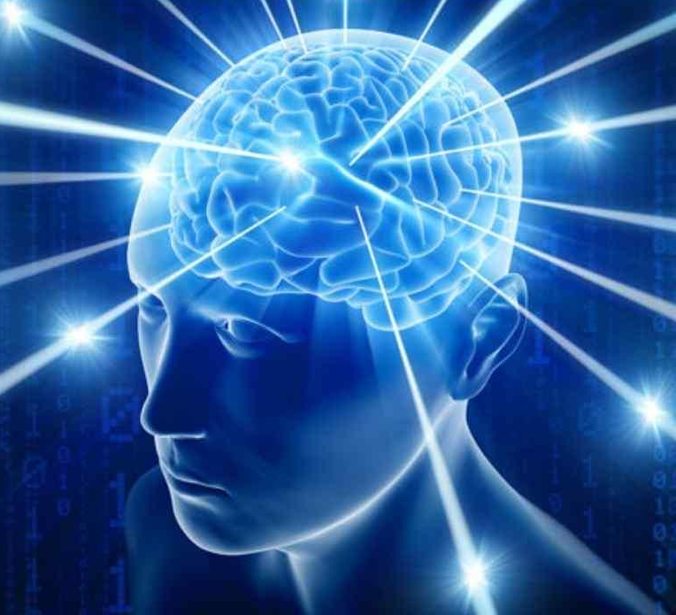
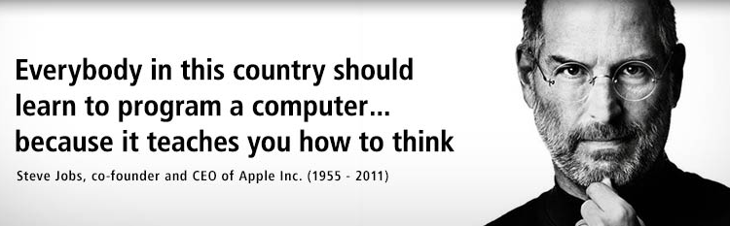
Why learn Python: RANGE OF APPLICATIONS
Web Dev
(Covered in the advanced course.)
• Make websites using frameworks like Django.
• Ability to handle asynchronous requests.
Big Data Analysis
• In-built features of supporting data processing for unstructured and unconventional data which is a common need in big data.
• Libraries like Pandas and SciPy aid with analysing data.
Machine Learning
• Plenty of libraries for ML like Keras, TensorFlow, and Scikit-learn for machine learning.
• Python acts an easier interface compared to Java etc.
• Python performs slower than C. Under the hood these libraries run on C anyway so it doesn’t matter.

Slide 12
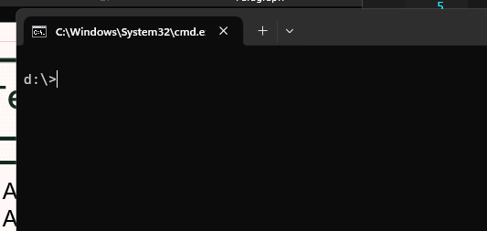
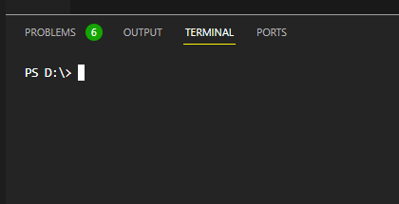
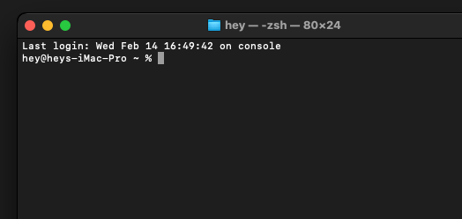
Terminal
A window where user interact with the operating system
A text-based console application by entering text input through the computer keyboard
and reading text output from the computer terminal.
Windows console is called the command prompt window & accepts MS-DOS commands.
macOS terminal accepts zsh commands, similar to sh command in Linux.

Slide 13
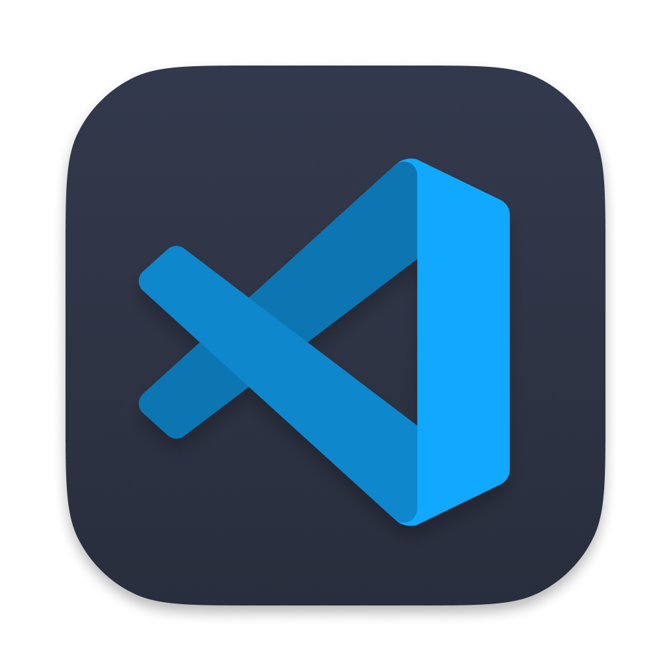
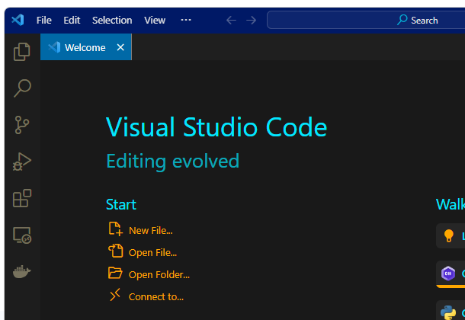
Code editor / IDE setup
Throughout the rest of the course, we will use Visual Studio Code. However, you are free to use any code editor or Python IDE you want.
Recommended:
PyCharm
VS code
Thonny
Atom
IDLE (This comes with the express Python installation so no further setup is required. Simply search for "IDLE" in your start menu.)

Slide 14
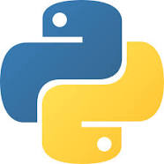
Python Installation
For Windows:
winget install -e -i --id=Python.Python.3.11 --source=winget --scope=machine
For macOS:
Open the Terminal app and install brew /bin/bash -c "$(curl -fsSL https://raw.githubusercontent.com/Homebrew/install/HEAD/install.sh)"
Install python with: brew install python
Type nano ~/.bash_profile and press Enter.
Add the following line to the file: export PATH="$PATH:/Library/Frameworks/Python.framework/Versions/3.12/bin"
Save the file by pressing Ctrl+O, then press Enter.
Close the file by pressing Ctrl+X.
Restart the Terminal app for the changes to take effect.

Slide 15
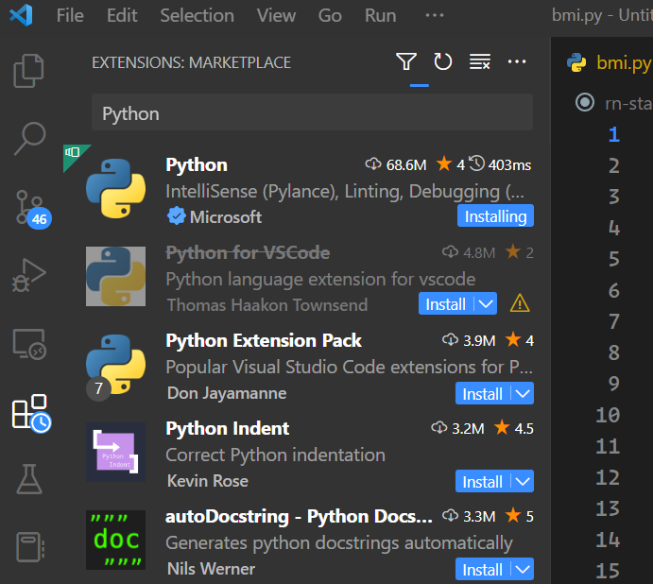
VS Code Installation and Extension Setup
For Windows:
winget install Microsoft.VisualStudioCode --override '/SILENT /mergetasks="!runcode,addcontextmenufiles,addcontextmenufolders"'
For macOS:
brew install --cask visual-studio-code
After Installation:
Click on the building blocks icon and search "Python" in the search bar and install the first extension that comes up. This gives us features like below and more. Feel free to add any other extension which you may find useful.
IntelliSense (Pylance)
Linting
Debugging
Code formatting
SEARCH
INSTALL
CLICK

Slide 16


Course material download : GitHub Resource
For Windows:
cd %homepath%/Downloads
winget install --id Git.Git -e --source winget
For macOS: cd ~/Downloads
Install Git with: brew install git
or
Install Xcode from AppStore (include Basic Git)
After Installation:
git clone <url>
For this week:
git clone https://github.com/ccsheff24/week1

Slide 17

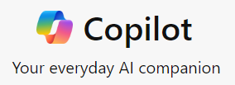
Generative AI
Since the release of ChatGPT in November 2022, Generative AI has been optimized for generating code snippet and debug.
You are welcome to use Generative AI to encounter any coding problem. My advice is use it as your last resort as fixing errors trains your problem-solving skills. Also, you are welcome to ask our mentors on discord support channel
Some popular free Generative AI are:
OpenAI’s ChatGPT
Google's Gemini
Microsoft Copilot

Slide 18
PYTHON BEGINNER COURSE
2024
2024
PYTHON
BEGINNER COURSE
Lesson 1
SHALEV LAU
/in/shalevl
/mushroomhater07

Slide 19
Python Basics
Data Types
Arithmetic operations
Variable & constant
Identifier
Type Casting
Input/ Output
String operations
Week 1 Project : BMI
Advanced Project: ºF to ºC

Slide 20
Data Types
Data types define a possible set of values and what operations can be done on them. Typically languages have primitives (basic data types from which all other data types are constructed).
In the case of Python every value is an object but don’t confuse this for an object type.
Data Types | Python Classes | Example | Description
Numeric | int, float, complex | 20, 20.5,2+5j | holds numeric values
String | str | "apple" | holds sequence of characters
Sequence | list, tuple, range | ["apple", "banana“] ("apple", "banana“) | holds collection of items
Mapping | dict | {"name" : "John", "age" : 36} | holds data in key-value pair form
Boolean | bool | True, False | holds either True or False
Set | set, frozeenset | {"apple", "banana“} | hold collection of unique items
Binary | bytes, bytearray, memoryview | b"Hello" | Hold binary (non-printable) data
number = 20
fruit = "pear"
print(type(fruit))
# type <class‘string’>

Slide 21
Arithmetic operations
Python follows the traditional mathematical operations and rules of precedence (BIDMAS).
If you ever need to do an operation on an existing variable you can put the operator in front of the assignment syntax.
Operator | Operation | Example
+ | Addition | 4 + 2 = 6
- | Subtraction | 5 - 3 = 2
* | Multiplication | 4 * 2 = 8
** | Exponent | 4 ** 2 = 16
/ | Division | 7 / 2 = 3.5
// | Floor (or Integer) division | 7 // 2 = 3 # 3.5 rounds to 3
% | Modulus | 7 % 5 = 2
x = 20
x = x / 2
print(x) #10
x = 20
x /= 2
print(x) #10
=

Slide 22
Variable
Variables work like they in maths, they store some value in memory.
What we just wrote is known by 3 names which are used interchangeably but incorrectly. Only one of them is technically correct in the context of Python.
Variable declaration - Declaration just specifies the type but doesn't allocate memory.
Variable definition – Definition associates the variable with a type and allocates memory.
Variable assignment – The name on the left-hand side now refers to the result of evaluating the right-hand side, regardless of what it referred to before (if anything)
The name given to the variable is called Identifier
fav_website = 'apple.com'
fish = 2

Slide 23
Python Identifier
The name that given to a variable and function are named as identifier
There are special rules:
They cant be python keywords (True, False, None, print)
They are case-sensitive ( Animal & animal are different variable
Whitespace is not allow ( calculated answer 🡺 calculated_answer )
Cannot use special symbol (e.g. !, @, #, $)
Begin with letter or _ .Cannot start with digit ( 1name )
👍 Good
Name
is_complete
num_of_people
😡 Bad
lMAao!
😱
1st_variable

Slide 24
Type Casting
Unlike other languages like JavaScript, Python prefer explicit is better than implicit. That means Python won't automatically type casting.
We also have to (explicitly) convert types so that they’re compatible with each other.
num1 = int(“5”)
num2 = int(-2.8)
num3 = float(“5”)
print(num1) # prints 5
print(num2) # prints -2
print(num3) # prints 5.0
print("It's " + 11 + "AM")
# TypeError: can only concatenate str (not "int") to str
print("It's " + str(11) + "AM")
# It’s 11 AM

Slide 25
Python I/O
We can use print keyword to output to terminal and get user input using input to assign a variable
print statement will automatically create a newline. To avoid this, we can add an argument end = '' before the closing bracket
input statement pauses execution of the program until Enter key is pressed. It takes 1 optional argument for the prompt
print("Is GTA", 6, "released?", False)
# Is GTA 6 released? False
print("hello", end = '')
print("world")
# helloworld
#
name = input("Enter your name: ")
print(name)
# Enter your name: James
# James

Slide 26
Format String
To reduce the amount of , or + while printing:
.format is a method available on all strings using the dot notation. If you specify index numbers, they’ll correspond with the ordered value you supplied in the method. Or you can use keyword arguments. Otherwise, they'll follow consecutive order.
OR
use the format specifiers and the % operator. The format specifiers must be in order with the argument list and must match the same data type
(%s string %f float %d integer)
f"string{variable}string" you can embed variables and expressions directly in f-strings.
print('{2} {0} {1}'.format('are in', 'order', 'We’))
# We are in order
print("%d %s sells %2.1f dollars" % (100, "apples", 48.23))
# 100 apples sells 48.2 dollars
last_name = "Obama"
print(f"His is {last_name}.")
THIS IS NOT THE SAME AS THE MODULUS OPERATOR.

Slide 27
String Operation: substring
Strings are simply a sequence of character(s) that can for a word or sentence and an index is the relative location of a thing
In python, index starts counting from 0. And use negative indexes to reference items at the end of the string. -1 represents the last character and so on…
We can get a character from a long string. Stating the index we want inside [] bracket
We can also get a part of a long string. This is called substring. We use : inside the [] bracket.
If [2:5] is set, python will output from index 2 to 4 only
This logic also applies for lists. In fact, string is just a list of character
print("CodeCreators"[0]) # C
print("CodeCreators"[-2]) # r
# get index 2 and 3 only
print("CodeCreators"[2:4]) # de

Slide 28
Comment
You might notice hash(#) symbol in the previous example. In python, it is for writing a single-line comment.
You can also write multiline comment by ("""). This usually appear at the front
Comments can be used to
Explain code
Make code more readable
Prevent execution when testing
"""
Written on 2024
Version 1.0
"""
fruit = "apple"
# assignment used
Shortcut key for most text editor:
Ctrl + / if you are on Windows
Cmd + / if you are on a Mac.

Slide 29
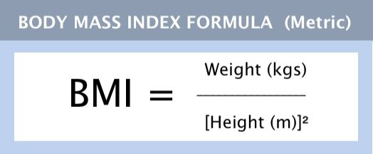
Week 1 Project: BMI calculator
BMI is a way to figure out your approximate level of body fat in an easy, inexpensive way.
.
Requirement:
user able to input height (in centimeters)
user able to input the weight (in kg)
user able to see the BMI index
BMI index output with any string formatting
# Final Result:
BMI Calculator
Enter your height in cm: 180
Enter your weight in kg: 75
Your BMI is: 23.148148148148145

Slide 30
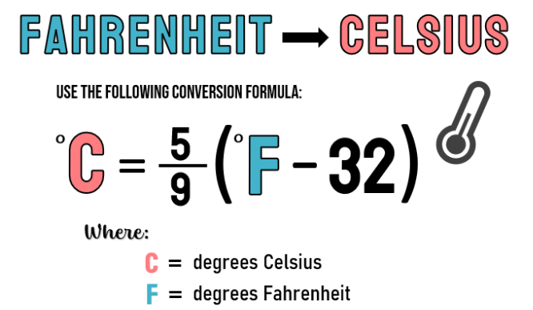
Week 1 Project: Advanced project
# Final Result:
Temperator Convertor
Enter temperature in F: 59
Current temperature in C: 15

Slide 31
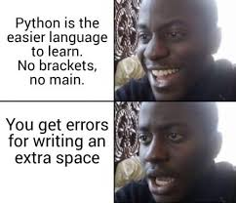
Meme of the week

